Slide 1
Monitoring, Evaluation, and Learning (MEL) Framework
Scale Toolkit

Slide 2
WHAT IS IT?
Imagine a Monitoring, Evaluation, and Learning (MEL) Framework as the project's navigation system.
It provides you with the means to continuously check your direction, measure your distance, and understand the terrain ahead.
It is a comprehensive plan that helps ensure that your project is performing effectively and offers the tools to adjust your course based on the insights you gain. This strategic instrument not only guides you towards your destination but also enhances the journey, making every step more insightful and impactful.
Photo: Hippocampus

Slide 3
WHAT IS IT?
A MEL Framework is a systematic approach to tracking a project's progress (Monitoring), understand its impact (Evaluation), and use those insights to improve your implementation and future initiatives (Learning).
1. Monitoring:
Monitoring is keeping a regular check on the project to make sure everything is going as planned and why.
2. Evaluation:
Evaluation is looking at how well the project is doing at certain milestones, or how it did after it has finished.
3. Learning:
Learning means using information from monitoring and evaluation to make better decisions now and in the future.
Photo: Hippocampus

Slide 4
WHY USE IT?
Make a better project – Monitoring acts as a tool, a dialogue with the project that helps pinpoint and enact valuable improvements and refinements. Monitoring does this by setting formal moments for the team to stop, focus on important questions, gather data, discuss the answers, and then adjust the project if needed. In short, monitoring is as a back-and-forth conversation that guides the project's choices; it's not just something you do alongside the project, it's part of the project itself.
Learning - Monitoring can lead to different types of learning. Questions asked during monitoring can push the team to look closer at their work, helping them figure out if a certain method is working. The data gathered can also help in later evaluations of the project.
Being accountable - Any requirements for reporting should be considered when setting up the monitoring system. This way, the data you collect will help with reporting later on.

Slide 5
ALIGNMENT WITH DVF FRAMEWORK
Your MEL Framework will be useful in assessing all components of the DVF framework - desirability, feasibility and viability. Here's how:
Desirability: is the innovation engaging the intended audience and having the intended impact on outcomes? Monitoring the activities, evaluating impact on key outcomes, and implementing learning from these will ensure to improve desirability of the innovation.
Feasibility: is there the culture and leadership to use data and learning, and does the team have the skills to implement the MEL framework? This allows us to ensure that we are developing a foundation of evidence-based decision-making.
Viability: is the system in place to deliver MEL as the innovation scales (i.e., are we developing data maturity)? MEL systems should be built with the viability of implementation and scale in mind.

Slide 6
HOW TO DEVELOP A MEL FRAMEWORK
The starting point for developing a comprehensive MEL framework should always be your Theory of Change*, as it represents the foundation for your framework.
MEL Framework
Theory of Change
At its core, the MEL framework needs to be clear about:
What questions you are seeking answers to
Why those questions are important to you
How you will find answers to those questions
Who will be responsible for finding the answers to these questions
*If you have not yet developed a ToC, we recommend that you check out the chapter on ToC Development and return to the MEL Framework after!

Slide 7
HOW TO DEVELOP A MEL FRAMEWORK
You can build your MEL framework one step at a time.
Step 8: Who will be responsible for answer each question?
Step 6: For each question, how will you know if you are successful?
Step 4: What would good look like for each question?
Step 7: When & how often will you need to ask each question?
Step 2: What monitoring questions are important?
Step 5: Where will you find the data to answer each question?
Step 3: Why is each of the questions important to you?
Step 1: Which components of your theory of change do you need to reflect on?
The next page defines each of these steps in more detail.

Slide 8
COMPONENTS OF A MEL FRAMEWORK
Theory of Change (ToC): This is the basis of your MEL Framework. It outlines how your organisation or project plans to achieve its goals and brings about change.
Monitoring Questions: We must identify what it is within our programme that we want to reflect on. It is likely that you will have lots of questions! List them all out so you can decide which are highest priority later.
Purpose: For each monitoring question, we need to understand why we are asking it. What is its relevance to our project or programme?
Success Criteria: This defines what success looks like for each question of focus. It's the standard against which we measure our progress for each question.
Data sources: This refers to where we can find the information needed to answer our monitoring questions. These could be assessments, surveys, interviews, reports, or even observations.
Indicators: This refers to precisely what evidence we will extract from our data sources to assess against our success criteria. These may be quantitative or qualitative in nature, but they must be measurable.
Frequency: This refers to how often and until when we will need to collect evidence regarding this specific question.
Owner: This refers to who will be responsible for ensuring that evidence is gathered to answer this specific question, according to the plan outlined in the MEL framework.

Slide 9
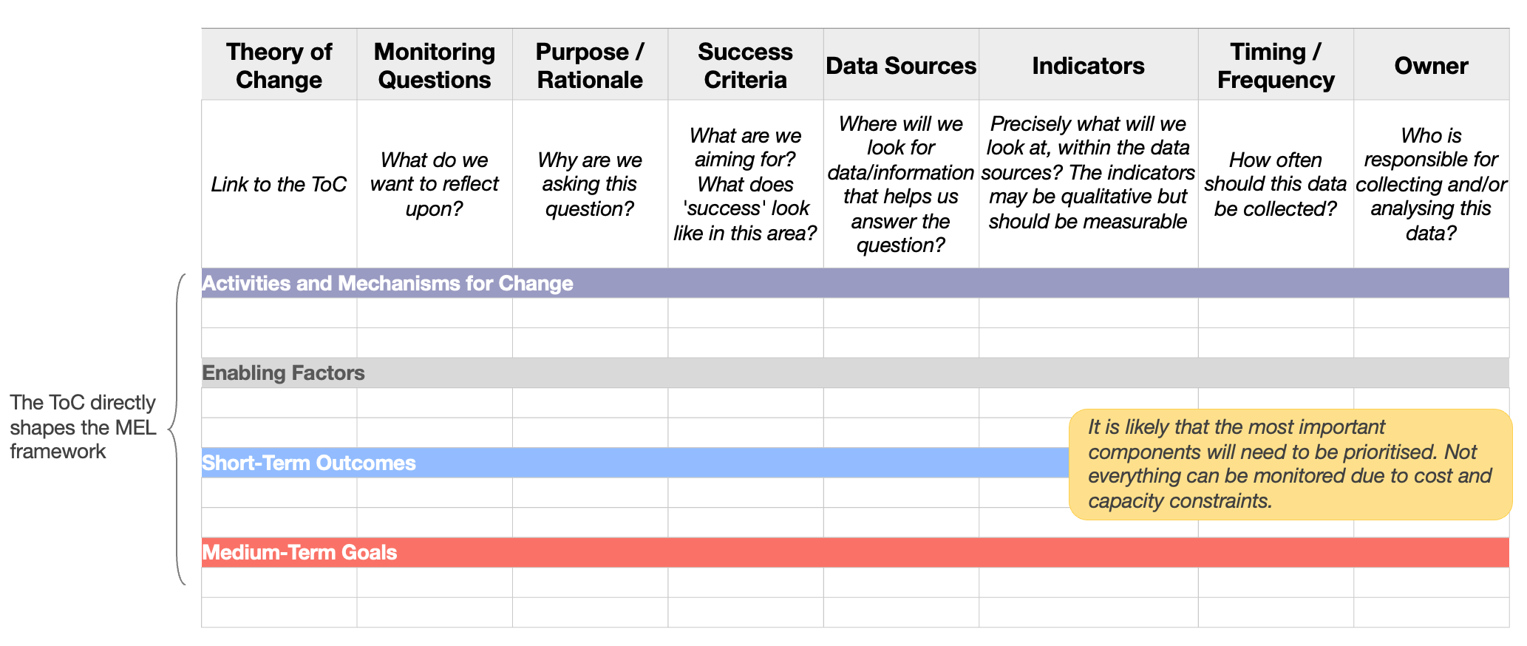
HOW TO DEVELOP A MEL FRAMEWORK
While there are many ways to develop a MEL Framework, here is one template to get you started. The easiest way to create one is with a spreadsheet, outlining these components in the columns, linked to each element of your Theory of Change.

Slide 10
LET’S USE AN EXAMPLE TO ILLUSTRATE
Dignitas is Kenyan organisation that empowers educators and school leaders to transform opportunities for the next generation through school partnerships that strengthen leadership, improve instructional quality, and provide infrastructural support.
LEADNOW APP
Dignitas is one of the Global Schools Forum Impact@Scale Labs finalists.
https://www.globalschoolsforum.org/page/Dignitas
Dignitas' LeadNow app is a tech tool to support remote coaching of school leaders and enhance school-based teacher development in Kenya.
This app is embedded in Dignitas’ digital training and coaching toolkit LeadNow, designed for and by School Leaders.
It was developed in 2021 and has undergone initial testing with approximately 800 school leaders.
Dignitas intends to reach 4,150 schools, targeting a total of 16,600 educators. Their goal is to impact the education of 750,000 children through direct school partnerships and 1,500,000 through government collaboration by 2027. This app was developed to help reach this goal.

Slide 11
Dignitas LeadNow App Theory of Change
Problem statement
Key Inputs & Activities
Mechanisms for change
Outputs
Mechanisms for change
Outcomes
Goals
Long-term goals
Train Instructional Leaders in three FLN pedagogical methods: formative assessment, data-driven, and differentiated instruction.
Few solutions exist for leaders to aid teachers lacking skills in Foundational Literacy and Numeracy (FLN) instruction.
Instructional Leaders support teachers in using different methods to check for understanding during lessons
There is improved pedagogical support to teachers on formative assessments, data driven instruction and differentiated instruction​
Instructional Leaders are enthusiastic about enhancing FLN skills and exhibit strong self-efficacy in applying learned concepts.
Offer how-to guides for strategy implementation.
Teachers will differentiate instruction to accommodate the learning needs, different learner types and abilities​
They possess expertise in formative assessments, data-driven, and differentiated instruction.
Instructional Leaders review and use teaching and learning data to inform necessary adjustments to teaching and learning processes​
There are improved learning outcomes for FLN​
Provide SBL Scenarios for practical strategy application.
Instructional Leader's support utilizes teacher lesson observations for feedback, models expectations on formative assessments, data-driven instruction, and differentiated instruction, and builds upon past coaching records to guide future actions and goals.
LeadNow offers evidence-based pedagogical approaches for impactful FLN, addresses knowledge gaps in instructional practices, provides contextually relevant strategies and resources, enables leaders to practice learned skills, delivers engaging content with videos and animations, and ensures timely, personalized, high-quality feedback for reflection and goal-setting
There is improved instruction for FLN​
Accountability Line
Teachers will review and use learner data to adjust teaching processes​
Supply Reflective Journals to help leaders identify strengths, growth areas, and enhance teacher support.
They possess expertise in formative assessments, data-driven, and differentiated instruction.
Instructional Leaders support teachers to tailor instruction to meet the learning needs, learning types and abilities of learners
Teachers will apply different methods to check for understanding during lessons​
Enable Instructional Leaders to set goals to boost teacher support and present feedback to guide goal setting and improve teacher support.
Critical/enabling factors
Instructional Leaders and teachers are motivated to enhance FLN practices
Leaders have smartphone and internet access.
Leaders, teachers, and stakeholders like Education Officers collaborate.
Leaders and teachers allocate time for skill practice.
Adequate funding and partnerships support LeadNow's scaling.

Slide 12
MEL FRAMEWORK EXAMPLE
This provides a small snapshot of a MEL framework, adapted from the Dignitas MEL framework:
Theory of Change | Monitoring Questions | Purpose / Rationale | Success Criteria | Data Sources | Indicators | Timing / Frequency | Owner
Link to the TA's ToC | What do we want to reflect upon? | Why are we asking this question? | What are we aiming for? What does 'success' look like in this area? | Where will we look for data/information that helps us answer the question? | Precisely what will we look at, within the data sources? The indicators may be qualitative but should be measurable | How often should this data be collected? | Who is responsible for collecting and/or analysing this data?
 | To what extent do instructional leaders exhibit positive attitudes towards learning FLN skills? | To understand whether the app’s content and learning are positively received by leaders. | The great majority of leaders show positive attitudes towards learning skills for improving FLN. | Survey | Average proportion of leaders showing positive attitudes on survey items related to learning FLN skills and concepts. | - Halfway through the programme - At the end of the programme | {add name or team}
 | To what extent do teachers use learner data to adjust teaching processes? | To assess whether the app leads to behaviour changes in teachers’ practices around assessment-informed practices. | Following the programme, at least 25% of teachers display assessment-informed practices and this increases over six months. | Observations | Average proportion of teachers who use learner data to adjust their practice. | - At the start of the programme - 2-3 months after the programme - 6 months after the programme | {add name or team}
Instructional Leaders are enthusiastic about enhancing FLN skills…
Output
Teachers will review and use learner data to adjust teaching processes​
Outcome

Slide 13
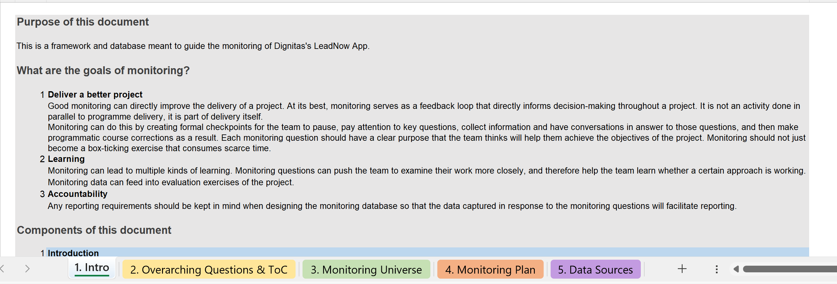
USING THE TOOL
The MEL tool has five tabs. Together, these tabs present the moving pieces of a MEL framework that can come together to help you measure and understand your programme.
Introduction
This first tab is a guidance tab and provides an overview of the purpose, structure and components of this tool. There is no action for you to complete here, other than reading through it.

Slide 14
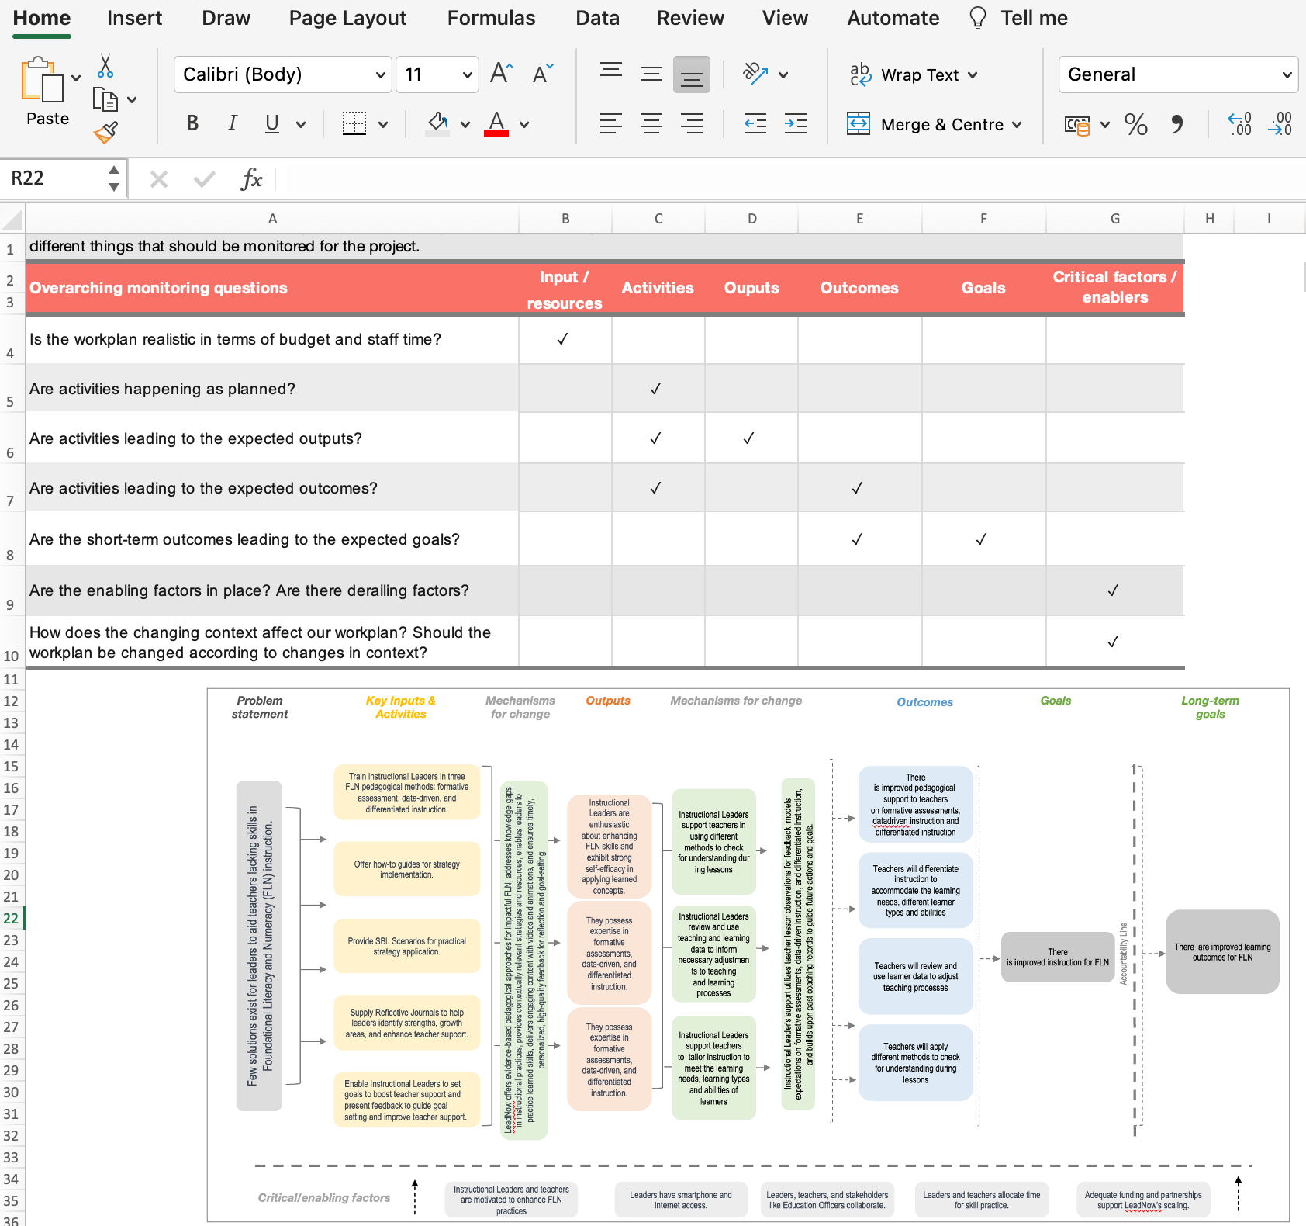
USING THE TOOL
Overarching Questions and ToC
The second tab in the document presents the high-level (overarching) questions that underpin each of the main sections of the theory of change (i.e. input/resources, activities, outputs, outcomes, enablers/critical factors).
These overarching questions are common across all monitoring frameworks and are meant to guide the development of your more specific monitoring questions that will require specific data to answer.
This tab is also a good place for you to paste in your theory of change, for easy access and reference.

Slide 15
USING THE TOOL
Monitoring universe
The third tab in the document presents a systematic and comprehensive breakdown of the universe of the possible monitoring questions and data sources that could in theory be targeted by the monitoring to probe each of the components of the theory of change (to the left of the accountability line) and potentially guide implementation adaptations and inform evaluation of impact.
Include all the questions that come to your mind. You may want to engage other team members in this exercise. We will narrow down the questions later in the exercise.

Slide 16
USING THE TOOL
Monitoring plan
The fourth tab in the document consists of the monitoring plan and can also be used as a database for the project.
The monitoring plan specifies for each monitoring question: the rationale, the success criteria, the data sources, the indicators, the timing / frequency, and the owner.
It is often not possible or practical to pursue all the monitoring questions, so strategic decision must be made regarding the key questions that will be the focus of the monitoring activities. This tab will thus contain only the prioritised questions selected from the monitoring universe and will be the focus of all monitoring activities. These decisions will be based on:
Your strategic priorities
Your reporting needs
Your available resources, including existing data sources
Practical / feasibility considerations
Notes:
The tab can be used as a database (in the columns to the right of the “Owner” column) where the monitoring data is recorded according to the frequency specified. This enables all monitoring data to be stored in one location, facilitating its analysis and eventually reporting.

Slide 17
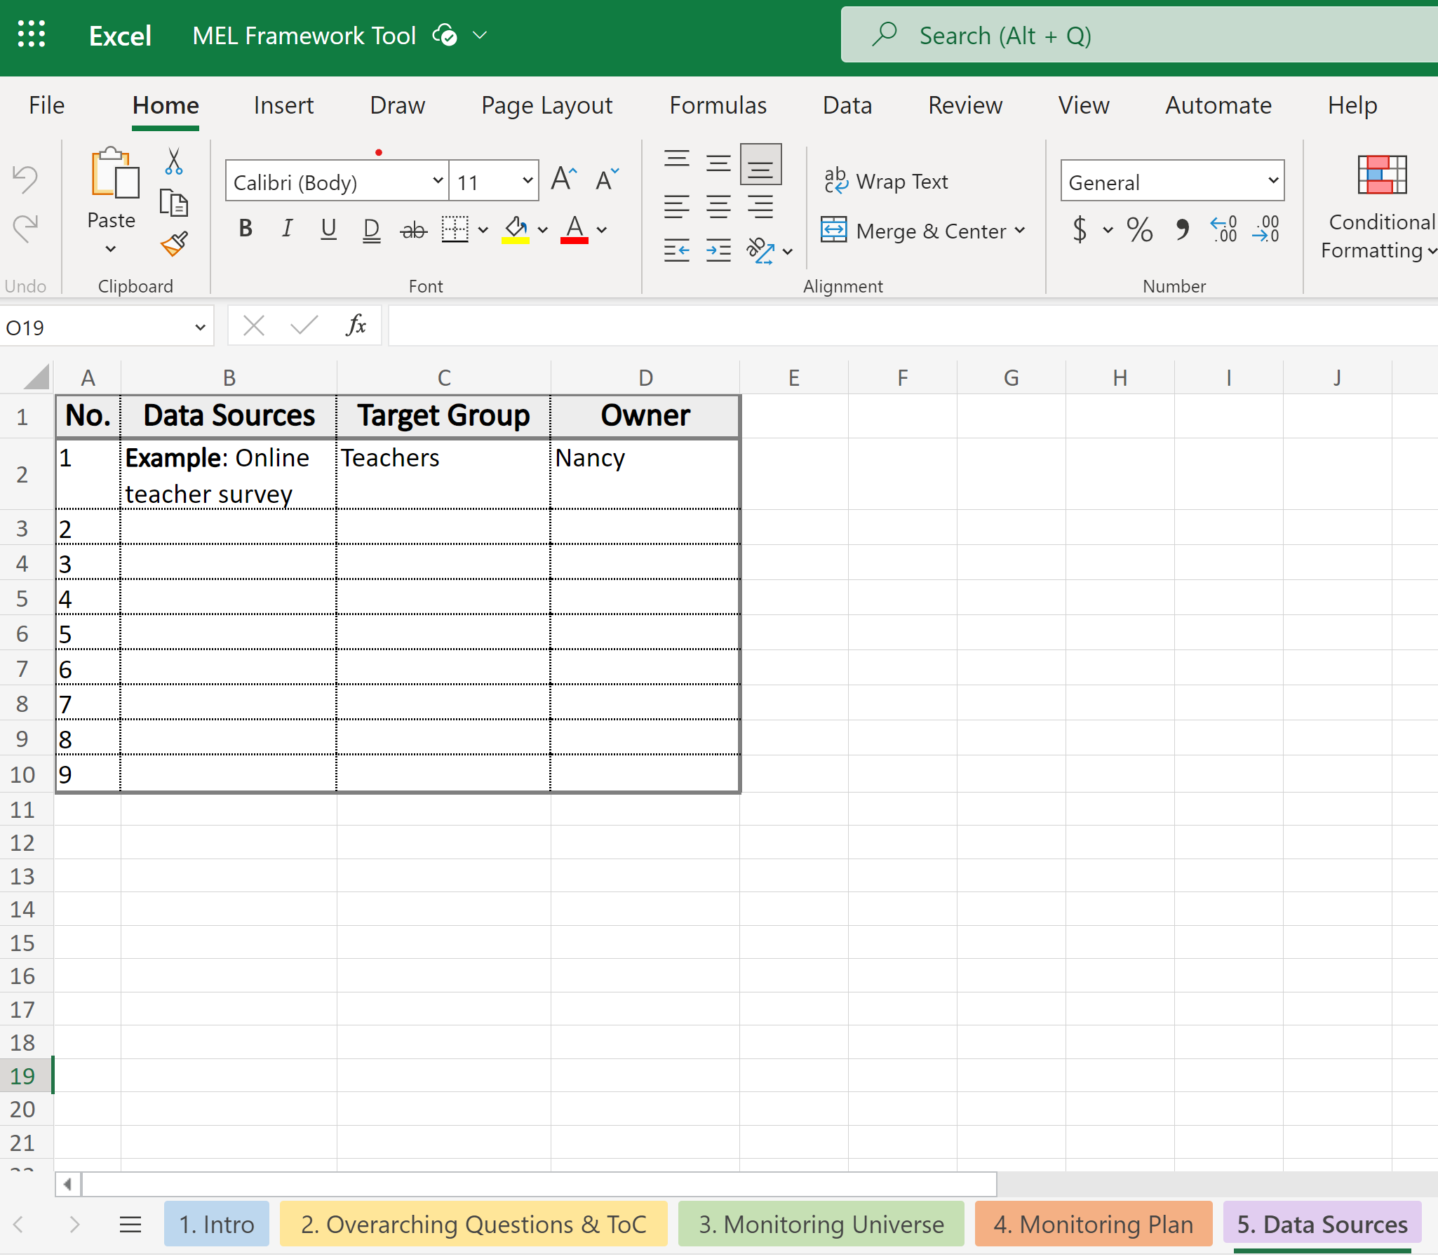
USING THE TOOL
Data Sources
The final tab contains the list of all data sources in your Monitoring Plan (tab 4) and the target group for these data sources.
You may already have these data sources in place, or you may need to develop new data collection mechanisms.
It is useful to identify a person (owner) who will be responsible for developing and overseeing these data sources.

Slide 18
Monitoring, Evaluation, and Learning (MEL) Framework
Scale Toolkit

Slide 19
Developing a Monitoring Plan
Scale Toolkit

Slide 20
WHAT IS A MONITORING PLAN?
In previous guidance, we learned about the Monitoring, Evaluation, and Learning (MEL) Framework as the project's navigation system. The Monitoring Plan is one of the tools of this system and represents the operationalisation of your MEL Framework.
To use our navigation analogy, the Monitoring Plan can be thought of as the highlighted route you select in your navigation system that shows you how to get to your destination. In your selection, you take into account the distance you need to travel, your required arrival time, as well as options to manage the roadworks, traffic jams and tolls along your route.
Notes:
Each project has constraints within which it is operating: Limited time, limited budget, limited data access, considerations like data collection burden (on schools or government officials, for example), limitation associated with data collection tools & measures, etc. In our analogy, these are our roadworks, traffic jams, and tolls that are found along our route and that we need to manage in considering how to get to our destination. Each one of these will need to be considered in developing our plan and prioritizing our MEL activities.

Slide 21
WHAT IS A MONITORING PLAN?
A Monitoring Plan builds on the Theory of Change and Monitoring Universe* and sets out the clear plan for tracking a project's progress.
1
2
3
Prioritising:​
It is not possible or practical to pursue all the monitoring questions in the Monitoring Universe, so you will prioritise the questions you will monitor.
​Defining success criteria:​
You will be specific about what success will look like for each one.​ ​
Specifying how and who:​
You will define how you will assess each question and be specific about who will be held responsible for tracking each question.
*If you have not yet developed a theory of change or monitoring universe, we recommend that you check out the toolkit guidance on ToC Development and MEL Framework!
Photo: Hippocampus

Slide 22
HOW TO DEVELOP A MONITORING PLAN
The starting point for developing a Monitoring Plan should always be your Theory of Change and Monitoring Universe, as they represent the foundations for your MEL Framework.
Monitoring Plan:
Which question should you prioritise?
What will success look like for each question?
How will you find answers to those questions and who will be responsible for finding the answers to these questions?
Monitoring Universe:
What are all the questions you could be seeking answers to?
Why are those questions important to you?
Theory of Change
?
*If you have not yet developed a theory of change or monitoring universe, we recommend that you check out the toolkit guidance on ToC Development and MEL Framework!

Slide 23
HOW TO DEVELOP A MONITORING PLAN
The starting point for developing a Monitoring Plan should always be your Theory of Change and Monitoring Universe, as they represent the foundations for your MEL Framework.
Monitoring Universe:
What are all the questions you could be seeking answers to?
Why are those questions important to you?
MEL Framework
?
Theory of Change
Monitoring Plan:
Which question should you prioritise?
What will success look like for each question?
How will you find answers to those questions and who will be responsible for finding the answers to these questions?
*If you have not yet developed a theory of change or monitoring universe, we recommend that you check out the toolkit guidance on ToC Development and MEL Framework!

Slide 24
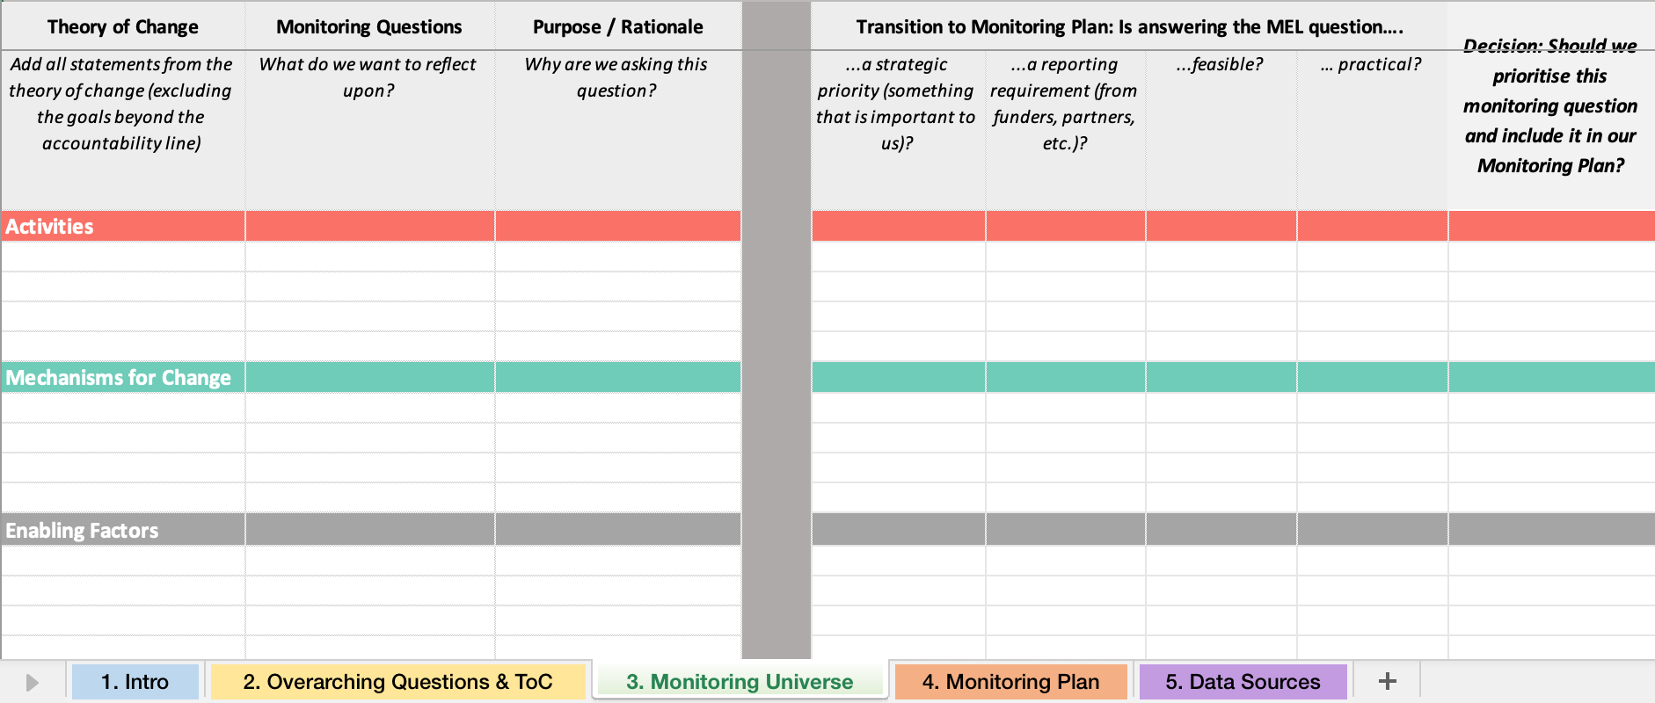
USING THE MEL FRAMEWORK TOOL TO COMPLETE THE MONITORING PLAN
Using the Monitoring Universe to Inform you Monitoring Plan
In completing your Monitoring Universe (third tab), use the calls in the right-hand columns under the heading “Transition to Monitoring Plan” to reflect on which monitoring question should be prioritised.
Notes:
The tab can be used as a database (in the columns to the right of the “Owner” column) where the monitoring data is recorded according to the frequency specified. This enables all monitoring data to be stored in one location, facilitating its analysis and eventually reporting.

Slide 25
USING THE MEL FRAMEWORK TOOL TO COMPLETE THE MONITORING PLAN
Monitoring Plan
Once you have completed the Monitoring Universe (third tab), the fourth tab in the MEL Framework tool consists of the Monitoring Plan and can also be used as a database for the project.
The Monitoring Plan specifies for each prioritised monitoring question: the rationale, the success criteria, the data sources, the indicators, the timing / frequency, and the owner.
Notes:
The tab can be used as a database (in the columns to the right of the “Owner” column) where the monitoring data is recorded according to the frequency specified. This enables all monitoring data to be stored in one location, facilitating its analysis and eventually reporting.

Slide 26
1. HOW TO PRIORITISE MEL QUESTIONS

Slide 27
1. HOW TO PRIORITISE MEL QUESTIONS
To complete the Monitoring Plan is to prioritise the monitoring questions listed in the Monitoring Universe part of the tool (see the last column of your Monitoring Universe tab) and copy them, along with their rationale, into the 2nd and 3rd columns of the Monitoring Plan part of the tool.

Slide 28
1. HOW TO PRIORITISE MEL QUESTIONS
There are several factors to consider in prioritising your MEL questions:
1. Your strategic priorities
2. Your reporting needs
3. What’s feasible?
4. What’s practical?
Let’s take each of these in turn…

Slide 29
1. HOW TO PRIORITISE MEL QUESTIONS
What will support your strategic priorities?
2. What will help you meet your reporting need?
Key questions to ask:
Where are we in our scaling journey? How secure / stable is our intervention design?
How will we use our monitoring data insights?
Do we want to use them to fine-tune our intervention design and implementation? If so, in what way?
Do we want to use them to determine impact? To what level of attribution?
Key questions to ask:
What do our current funder(s) want to know?
What might our future funder(s) want to know?
What does our Board want to know?
What do our beneficiaries / stakeholders want to know?
What level of detail do we need for reporting (e.g. in terms of disaggregation)?
Discuss these questions with your team. Based on your answers, review your list of monitoring questions (tab 3 of the tool) and flag the ones that will best help you meet your strategic objectives.
Discuss these questions with your team. Based on your answers, review your list of monitoring questions (tab 3 of the tool) and flag the ones that will best help you meet your reporting needs. Are there any overlaps with the previous step?
?
?

Slide 30
1. HOW TO PRIORITISE MEL QUESTIONS
3. What’s feasible?
4. What’s practical?
Key questions to ask:
What data would be needed to meaningfully answer the MEL questions?
What data are already available? What data collection tools could easily be used or adapted? What is the cost associated with this?
How much time do we have left and what data could be collected within this time?
Key questions to ask:
What level of data collection burden is acceptable for our beneficiaries / stakeholders?
What data collection activities are feasible within the local context (e.g. hard-to-reach schools, conflict areas, etc.)?
How much capacity / expertise do we have (or have access to) for monitoring activities?
Discuss these questions with your team. Based on your answers, review your list of monitoring questions from the previous steps and flag the ones that will be feasible.
Discuss these questions with your team. Based on your answers, review your list of monitoring questions from the previous steps and flag the ones that will be feasible.
?
?

Slide 31
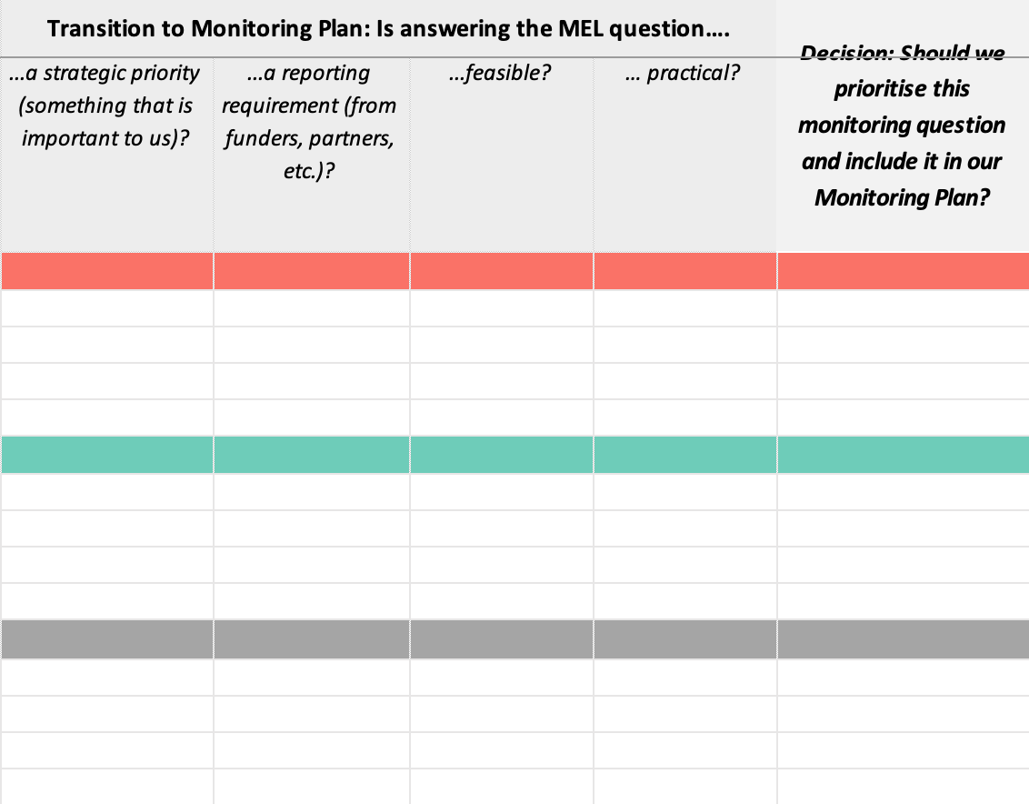
1. HOW TO PRIORITISE MEL QUESTIONS
Making your decision
Using the tool, you can use the following general guideline to help narrow down your MEL questions:
If a monitoring question is neither a strategic or reporting requirement, it should generally not be selected as a priority question to pursue.
If a monitoring question is either a strategic or reporting priority (or both), then your decision to prioritise will depend on whether it is feasible and practical:
If a monitoring question is both feasible and practical, it can then be prioritised
If a monitoring question is neither feasible nor practical, it should not be pursued.
If a monitoring question is feasible but not practical, it should be considered further to decide if it should be prioritised.

Slide 32
2. HOW TO DEFINE SUCCESS

Slide 33
2. HOW TO DEFINE SUCCESS
The second step in completing the Monitoring Plan is to define what success will look like for each of your prioritised questions, and clearly specify this in the 4th column of the Monitoring Plan part of the tool.

Slide 34
2. HOW TO DEFINE SUCCESS
Tips for defining your success criteria:
Think about what your intervention aims to achieve and what this will look like in real life (e.g. in the classroom).
Don’t worry about how this will be captured / measured yet.
Make sure each prioritised MEL question has clear success criteria.
Make sure the success criteria are specific enough to enable you to draw meaningful conclusions at the end of your intervention.
Why is it important to define your success criteria?
At the end of your project, for each of your prioritised MEL questions, you will compare your data/indicators to the success criteria.

Slide 35
LET’S USE AN EXAMPLE TO ILLUSTRATE
LEADNOW APP
Dignitas' LeadNow app is a tech tool to support remote coaching of school leaders and enhance school-based teacher development in Kenya.
This app is embedded in Dignitas’ digital training and coaching toolkit LeadNow, designed for and by School Leaders.
It was developed in 2021 and has undergone initial testing with approximately 800 school leaders.
Dignitas intends to reach 4,150 schools, targeting a total of 16,600 educators. Their goal is to impact the education of 750,000 children through direct school partnerships and 1,500,000 through government collaboration by 2027. This app was developed to help reach this goal.
Dignitas is a Kenyan organisation that empowers educators and school leaders to transform opportunities for the next generation through school partnerships that strengthen leadership, improve instructional quality, and provide infrastructural support. Dignitas is one of the Global Schools Forum Impact@Scale Labs finalists.
https://www.globalschoolsforum.org/page/Dignitas

Slide 36
Dignitas LeadNow App Theory of Change
Problem statement
Key Inputs & Activities
Mechanisms for change
Outputs
Mechanisms for change
Outcomes
Goals
Long-term goals
Train Instructional Leaders in three FLN pedagogical methods: formative assessment, data-driven, and differentiated instruction.
Few solutions exist for leaders to aid teachers lacking skills in Foundational Literacy and Numeracy (FLN) instruction.
Instructional Leaders support teachers in using different methods to check for understanding during lessons
There is improved pedagogical support to teachers on formative assessments, data driven instruction and differentiated instruction​
Instructional Leaders are enthusiastic about enhancing FLN skills and exhibit strong self-efficacy in applying learned concepts.
Offer how-to guides for strategy implementation.
Teachers will differentiate instruction to accommodate the learning needs, different learner types and abilities​
They possess expertise in formative assessments, data-driven, and differentiated instruction.
Instructional Leaders review and use teaching and learning data to inform necessary adjustments to teaching and learning processes​
There are improved learning outcomes for FLN​
Provide SBL Scenarios for practical strategy application.
Instructional Leader's support utilizes teacher lesson observations for feedback, models expectations on formative assessments, data-driven instruction, and differentiated instruction, and builds upon past coaching records to guide future actions and goals.
LeadNow offers evidence-based pedagogical approaches for impactful FLN, addresses knowledge gaps in instructional practices, provides contextually relevant strategies and resources, enables leaders to practice learned skills, delivers engaging content with videos and animations, and ensures timely, personalized, high-quality feedback for reflection and goal-setting
There is improved instruction for FLN
Accountability Line
Teachers will review and use learner data to adjust teaching processes​
Supply Reflective Journals to help leaders identify strengths, growth areas, and enhance teacher support.
They possess expertise in formative assessments, data-driven, and differentiated instruction.
Instructional Leaders support teachers to tailor instruction to meet the learning needs, learning types and abilities of learners
Teachers will apply different methods to check for understanding during lessons​
Enable Instructional Leaders to set goals to boost teacher support and present feedback to guide goal setting and improve teacher support.
Critical/enabling factors
Instructional Leaders and teachers are motivated to enhance FLN practices
Leaders have smartphone and internet access.
Leaders, teachers, and stakeholders like Education Officers collaborate.
Leaders and teachers allocate time for skill practice.
Adequate funding and partnerships support LeadNow's scaling.

Slide 37
2. HOW TO DEFINE SUCCESS (AN EXAMPLE)
This provides a small snapshot of a MEL plan, adapted from the Dignitas MEL framework:
Theory of Change | Monitoring Questions | Purpose / Rationale | Success Criteria
 | Has the training been successfully administered? | To understand if the implementation of the training was completed as planned. | All leaders enrolled in the programme have completed the training sessions in each of the three methods.
 | To what extent do instructional leaders exhibit positive attitudes towards learning FL skills? | To understand whether the app’s content and learning are positively received by leaders. | There is an increase in the proportion of leaders with positive attitudes towards learning skills for improving FL over the period of the programme, with at least 75% of leaders showing mostly positive attitudes at the end of the programme.
 | To what extent do teachers use learner data to adjust teaching processes? | To assess whether the app leads to behaviour changes in teachers’ practices around assessment-informed practices. | Following the programme, at least 25% of teachers display assessment-informed practices and this increases over the six months period after the programme.
Notice that the success criteria should not be….
Training sessions were held | This won’t tell you whether they were well-enough attended to have an impact This won’t tell you if all 3 components of the training took place
Leaders took part in the training | This won’t tell you if they showed up just on the first day and then didn’t come back
Train leaders in 3 foundational learning pedagogical methods
Activity
Instructional Leaders are enthusiastic about enhancing FL skills
Leaders show positive attitudes | This won’t be specific enough for you to draw a conclusion at the end – how many leaders do you expect to shift their attitudes after the programme if all goes well?
Output
Teachers change their practices | This won’t be specific enough for you to draw a conclusion at the end – you need to be specific now about how much impact on teacher practice you expect to see at the end of the programme and over time. This won’t be specific enough about the type of practice you would expect to see change in the classroom.
Teachers will review and use learner data to adjust teaching processes​
Outcome

Slide 38
3. HOW TO FIND THE ANSWERS (AND WHO WILL BE RESPONSIBLE)

Slide 39
3. HOW TO FIND THE ANSWERS (AND WHO WILL BE RESPONSIBLE)
The third step in completing the Monitoring Plan is to specify HOW you will answer the prioritised monitoring questions. This includes identifying the data sources, indicators, frequency of data collection and person responsible for ensuring this happens. This information is then entered into the 5th to 8th columns of the Monitoring Plan part of the tool.

Slide 40
3. HOW TO FIND THE ANSWERS (AND WHO WILL BE RESPONSIBLE)
What does each category / column mean?
1
2
Data sources:​
This refers to where we can find the information needed to answer our monitoring questions. These could be assessments, surveys, interviews, reports, or even observations.
Indicators:​
This refers to precisely what evidence we will extract from our data sources to assess against our success criteria. These may be quantitative or qualitative in nature, but they must be measurable.
​
Photo: Hippocampus
“Without data, you’re just another person with an opinion” W. Edwards Deming (Economist and statistician)
3
4
Frequency:
This refers to how often and until when we will need to collect evidence regarding this specific question.
Owner:
This refers to who will be responsible for ensuring that evidence is gathered to answer this specific question.

Slide 41
3. HOW TO FIND THE ANSWERS (AND WHO WILL BE RESPONSIBLE)
BACK TO OUR EXAMPLE…
This provides a small snapshot of the remainder components of the MEL plan, adapted from the Dignitas MEL framework:
Theory of Change | Monitoring Questions | Purpose / Rationale | Success Criteria | Data Sources | Indicators | Timing / Frequency | Owner
 | Has the training been successfully administered? | To understand if the implementation of the training was completed as planned. | All leaders enrolled in the programme have completed the training sessions in each of the three methods. | Attendance records | Proportion of leaders who completed all training required for each of the 3 pedagogical methods | - At the end of each training component | Training lead
 | To what extent do instructional leaders exhibit positive attitudes towards learning FL skills? | To understand whether the app’s content and learning are positively received by leaders. | There is an increase in the proportion of leaders with positive attitudes towards learning skills for improving FL over the period of the programme, with at least 75% of leaders showing mostly positive attitudes at the end of the programme. | Survey of leaders | Average proportion of leaders showing positive attitudes on survey items related to learning FL skills and concepts. | - Halfway through the programme - At the end of the programme | Data lead
 | To what extent do teachers use learner data to adjust teaching processes? | To assess whether the app leads to behaviour changes in teachers’ practices around assessment-informed practices. | Following the programme, at least 25% of teachers display assessment-informed practices and this increases over the six months period after the programme. | Classroom observations | Average proportion of teachers who use learner data to adjust their practice. | - At the start of the programme - 2-3 months after the programme - 6 months after the programme | Data lead
Train leaders in 3 foundational learning pedagogical methods
Activity
Instructional Leaders are enthusiastic about enhancing FL skills
Output
Outcome
Teachers will review and use learner data to adjust teaching processes​

Slide 42
3. HOW TO FIND ANSWERS: SELECTING OUTCOME MEASURES
1. Measuring what you need to measure
2. Measuring what is feasible to measure
3. Measuring outcomes that will be trusted
Considerations for selecting outcome measures
Selecting outcome measures and tools involves several key considerations to ensure the effectiveness and relevance of your monitoring efforts.
Detailed guidance on the selection of outcome measures is beyond the scope of this mini-guide, but here we present some of the key considerations, organised under three main areas (see diagram to the right).
Each area is described further in the next pages.

Slide 43
3. HOW TO FIND ANSWERS: SELECTING OUTCOME MEASURES
Considerations for selecting outcome measures
1. Measuring what you need to measure
3. Measuring outcomes that will be trusted
2. Measuring what is feasible to measure
Relevance to goals: Ensure that the outcome measures directly relate to the specific objectives of your intervention (as per your ToC).
Specificity: Ensure the tools can specifically measure the intended outcomes and that it covers all necessary aspects of the outcome being measured (triangulation can help here, whereby you use multiple measures and data sources to triangulate findings and provide a more comprehensive picture).
Validity: Choose measures that accurately reflect the concepts they are intended to assess.
Sensitivity: Ensure the measures are sensitive enough to detect changes over time, especially for interventions expected to produce small effects.
Benchmarking: Consider how the data can be compared with benchmarks or standards to assess performance.

Slide 44
3. HOW TO FIND ANSWERS: SELECTING OUTCOME MEASURES
Considerations for selecting outcome measures
1. Measuring what you need to measure
3. Measuring outcomes that will be trusted
2. Measuring what is feasible to measure
Resources available: Ensure that the tools are feasible given the available resources and technical capacity of the team.
Ease of administration: Choose tools that are straightforward to administer and do not impose excessive burden on participants or data collectors.
Scalability: Consider whether the tools can be scaled up or adapted for use in different settings or larger populations.
Long-term use: Consider whether the tools and measures can be used for long-term monitoring and evaluation, beyond the immediate scope of the current intervention.

Slide 45
3. HOW TO FIND ANSWERS: SELECTING OUTCOME MEASURES
Considerations for selecting outcome measures
1. Measuring what you need to measure
3. Measuring outcomes that will be trusted
2. Measuring what is feasible to measure
Accuracy: Ensure that data collected will be accurate.
Reliability: Ensure that the tools produce consistent and stable results over time and across different contexts.
Standardisation: Use standardised tools where possible to allow for comparison across different programs or studies.
Stakeholder Input: Engage stakeholders (e.g., educators, students, parents, funders) in the selection process to ensure the measures are relevant and acceptable.
Cultural Relevance: Ensure that the tools are culturally appropriate and sensitive to the context of the population being studied.

Slide 46
YOUR MONITORING PLAN
You are now ready to create your own Monitoring Plan!
Click here to find an interactive template:
MEL Framework and Monitoring Plan Tool.xlsx

Slide 47
Monitoring Plan
Scale Toolkit

